Slide 1
Renewable Energy Communities
Regulatory Framework, Benefits and Challenges
Giulia Taromboli
Regulation of Electric Power Systems
Academic Year 2022/2023

Slide 2
Agenda
EU Directive and Italian Transposition
Diffusion on the Italian Territory
Benefits
Challenges
Conclusions

Slide 3


EU Directive and Italian Transposition
2018
Legal entities made by natural person, small-medium size entrepreneurs and local authorities that utilize, store, share and sell self-produced electricity from RES
EU Directive 2018/2011
Not the primary commercial activity
On volunteer basis
Energy shared on public distribution grid
Incentivised
Main goal: environmental, economic and social benefits

Slide 4
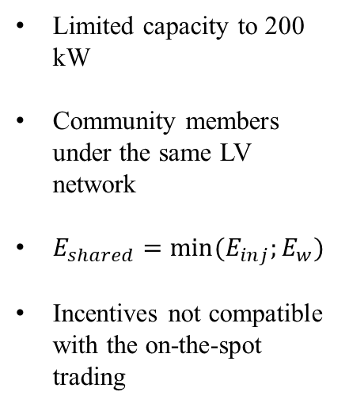
EU Directive and Italian Transposition
2020
Law 2020/08
Consultation Document 318/2020
Ministerial decree 16/06/2020
Limited capacity to 200 kW
Community members under the same LV network
$E_{shared}=min⁡(E_{inj};E_{w})$
Incentives not compatible with the on-the-spot trading
Shared electricity reimbursed of some network charges components
Coefficient of network losses avoided of 2.6% for LV plants
Incentive of 110 €/MWh on shared electricity for a period of 20 years

Slide 5
EU Directive and Italian Transposition
2021
2022
Legislative decree 199/21
National Resilience and Recovery Plan
Consultation Document 727/2022
Incentive as a tariff in form of single adjustment
Incentive granted with a tendering procedure up to the achievement of a predefined power
2.20 million Euro for municipalities with less than 5000 inhabitants
Community members connected in the same market area
Shared electricity for area underlying the same primary substation

Slide 6
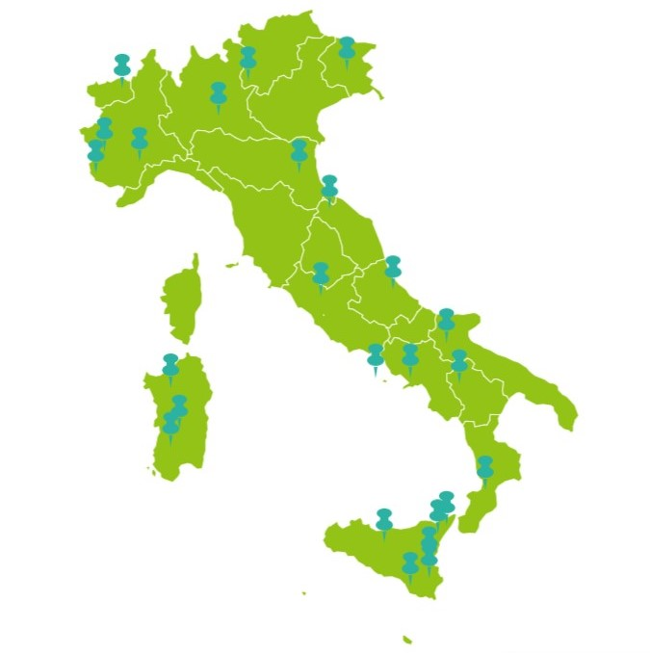
Diffusion on the Italian Territory
About 25 active REC in compliance with the law 2020/08

Slide 7
Benefits
Environmental
Explicitly based on RES
Economical
Reimbursement of some network charges components
Incentive on shared electricity
Social
Energy Justice
Payment at zonal price of injected energy
Reinforcement of sense of community
Empowerment of the community

Slide 8
Benefits: Energy Justice
Procedural Justice
Recognitional Justice
Distributional Justice
Non-discriminatory and inclusive participation
Barrier to entry: community business model, lack of social and economic capital
Access to services that vulnerable consumers don’t usually benefit
Possible tools: lower tariffs
Accommodate needs of underrepresented social groups
Possible tools: active participation of vulnerable consumers in the decision-making

Slide 9
Challenges
Non-existing sense of community
Agreement on amount of shared electricity
Profit sharing
Lack of specialised knowledge
Underlying area of primary substation

Slide 10
Challenges: Role of DSOs
Identify the underlying areas of every primary substation, also considering the future network deployments
Map published in DSO website
Third parties consultations
Updated map with observation
Next upload at least every 2 years

Slide 11
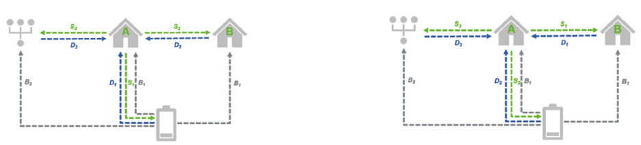
Challenges: Energy Sharing
Battery
Community
Grid
Community
Grid
Battery
Self-consumption optimization
Peer-to-Peer trading optimization

Slide 12
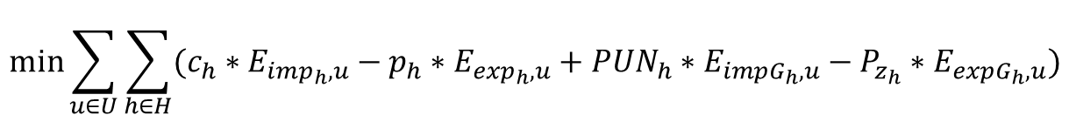
Challenges: Energy Sharing
$$\min{\sum_{u∈U}{\sum_{h∈H}{(c_{h}∗E_{imp_{h},u}−p_{h}∗E_{exp_{h},u}+PUN_{h}∗E_{im{pG}_{h},u}−P_{z_{h}}∗E_{ex{pG}_{h},u})}}}$$
Min
Cost - Rev
User energy balance
Community energy balance
POD energy limitation
Storage systems
Schedulable loads
Non-interruptible loads

Slide 13
Challenges: Profit Sharing
Sharing Mechanism 1
Sharing Mechanism 2
Sharing Mechanism 3
Ownership rights
Energy virtually shared
Number of consumers
Energy virtually shared
Demand
Self-generated electricity
Ownership rights
Energy virtually shared
Effort for increasing energy shared
Share of profit
Share of profit
Share of profit

Slide 14
Conclusions
Powerful tool to contrast some of the main issues that our society is facing today
Expected to grow in the next years
Implementation is still lacking today
Necessity to overcome the main challenges to fully accomplished their development in the future

Slide 15
Thank you for the attention!

